Slide 1

SCHEDULING EVENTS
Under the guidance of :
Prof. Ahmad Reza Madabadi
Prof. Sakshi Sharma
Prof. Silviya Paskaleva
Cégep de la Gaspésie et des Îles, Montreal

Slide 2
Agenda
1. What is our project about and how did we do
2. Features of the application
3. Technologies used
4. Problems faced during the project
5. Working screens
6. How did we manage to do our work

Slide 3


What is Scheduling Events

Slide 4
How did we do ?
visual prototype
My SQL
functional and non-functional requirements
1
3
5
2
4
6
UML diagrams
Android studio
Git

Slide 5

Features
Student/Teacher
Create event
Join event
Comment event
Share event
Search event
View upcoming events
Admin
Manage students
Manage teachers
Manage comments
Manage events

Slide 6

Technologies used?
Android
Draw.io, Lucid Chart
Git Hub
My SQL
Figma
Java

Slide 7

Problems Faced
Share event
Creating account for user(student/teacher)
UML Diagrams and Fully dressed use cases
Prototype

Slide 8
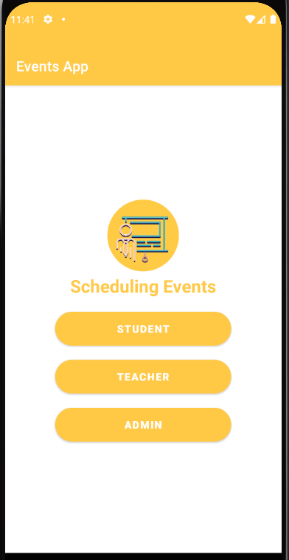
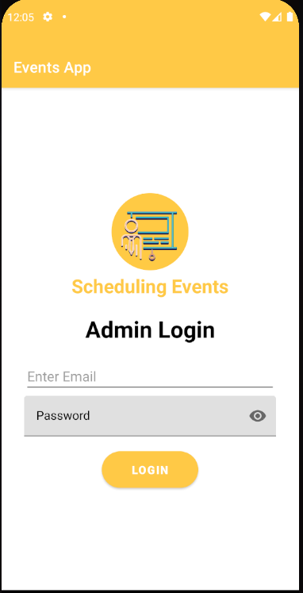
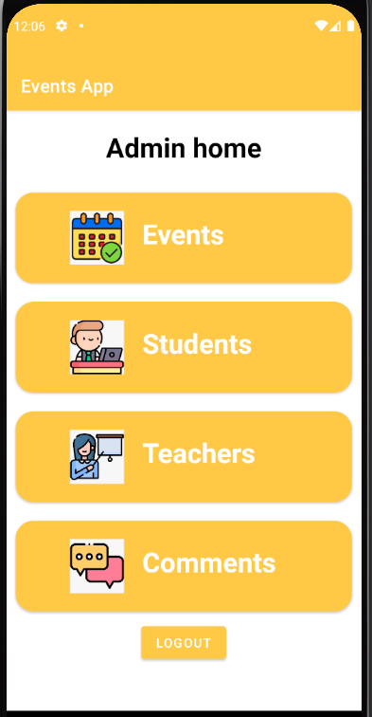
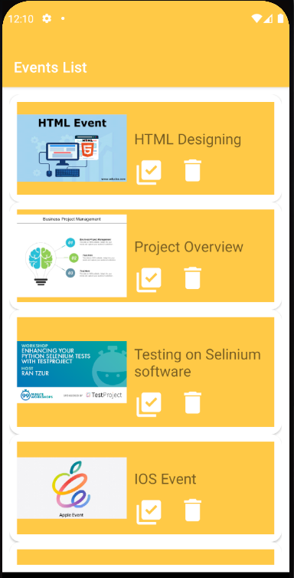
Working Screens

Slide 9
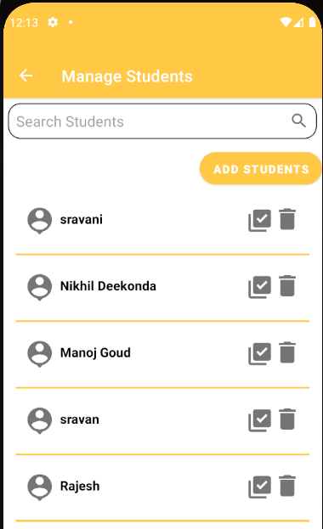
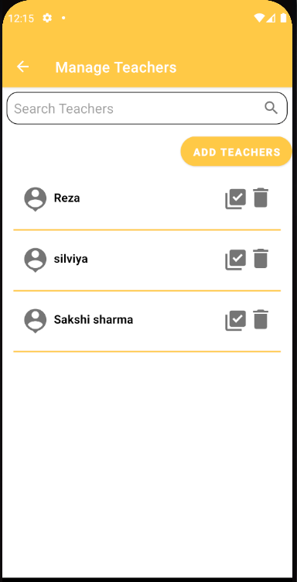
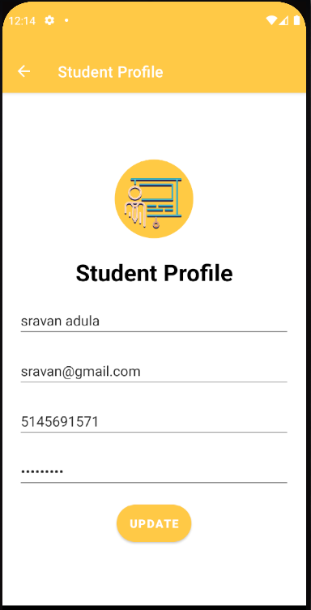
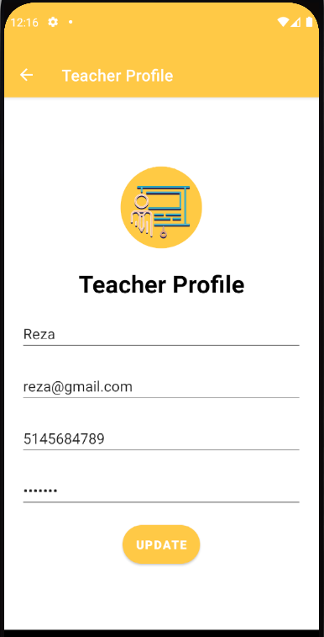
Working Screens

Slide 10
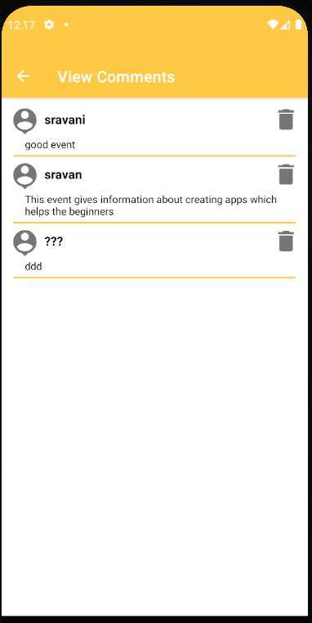
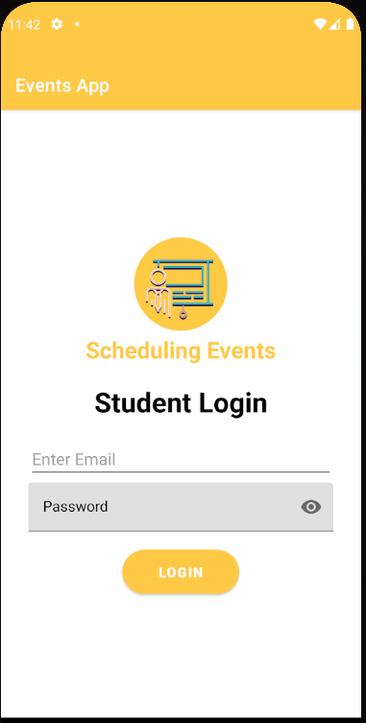
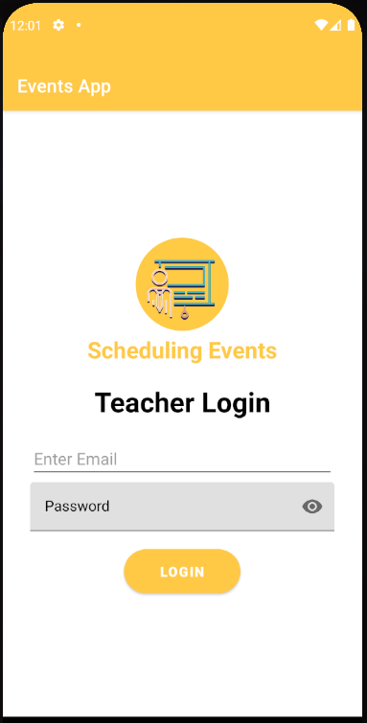
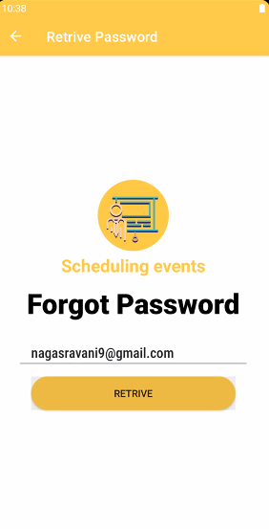
Working Screens

Slide 11
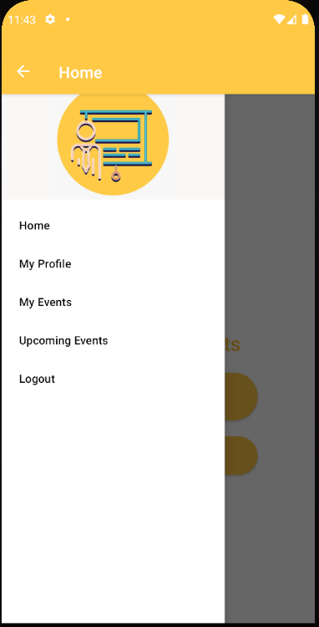
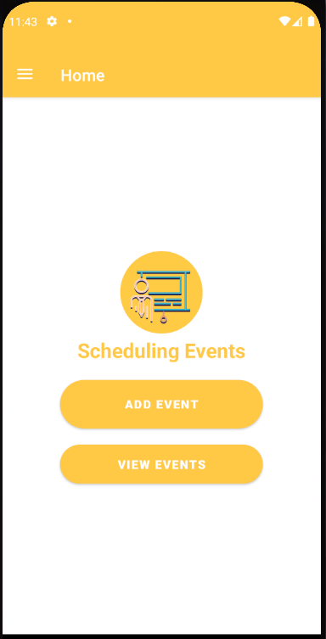
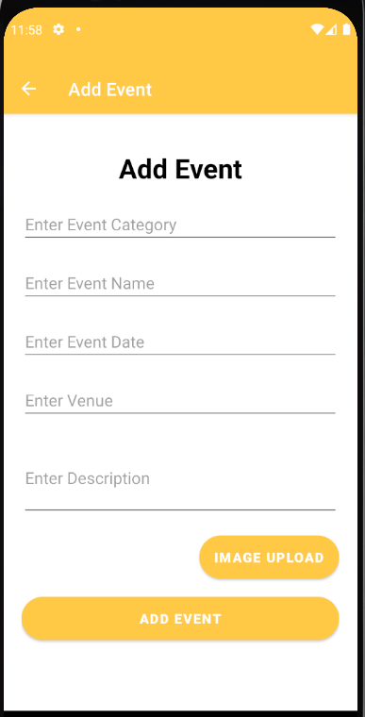
Working Screens

Slide 12
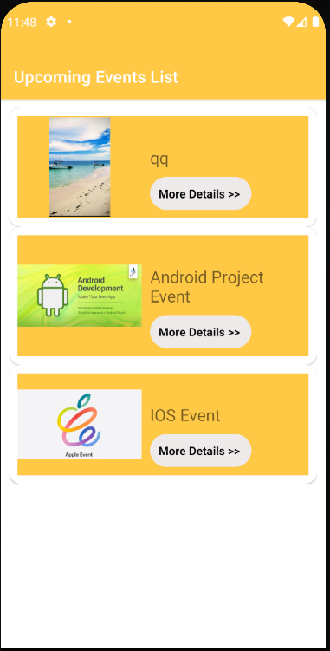
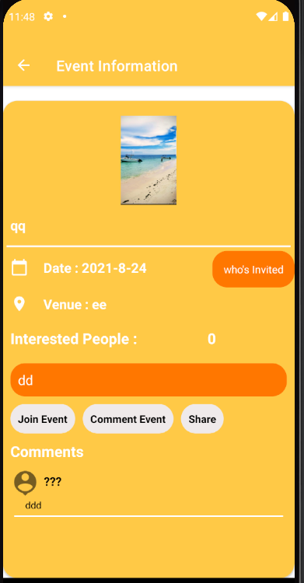
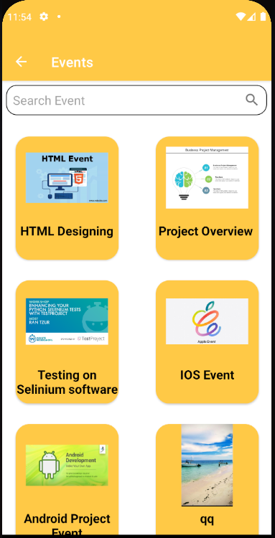
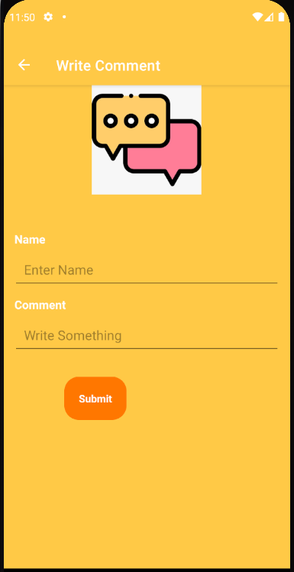
Working Screens

Slide 13
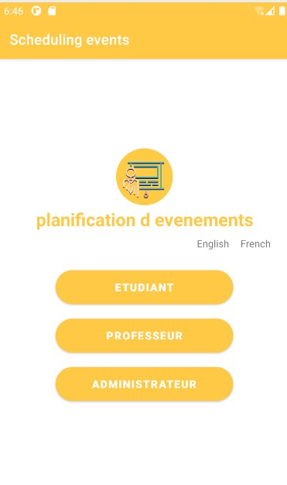
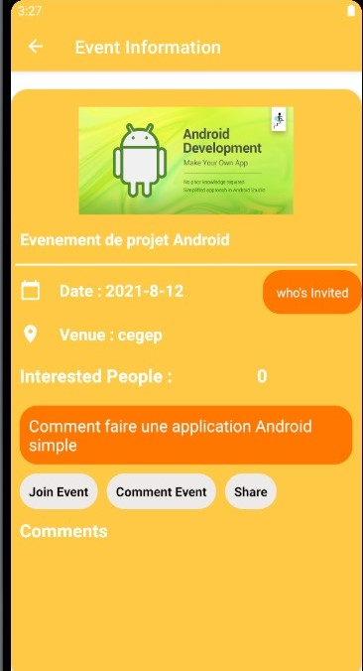
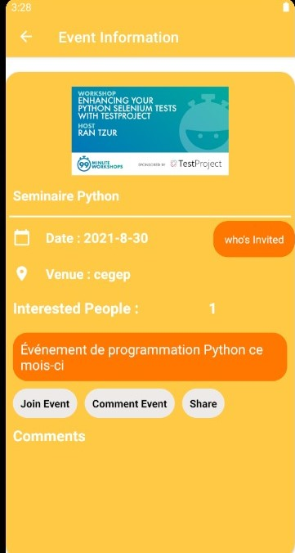
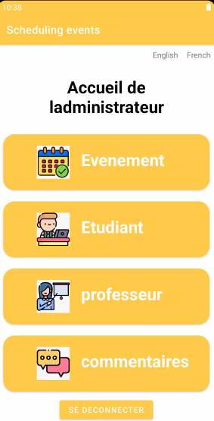
Working Screens

Slide 14

Conflicts
GitHub made our job easier to collaborate amongst our teammates and work on the application development

Slide 15

Team working remotely
Divided work equally
Working remotely - stay connected
Daily sprints, audio and video calls
Setup home work stations
Our teacher – all time support

Slide 16
Strenghts
Communication with teachers and students
Future events
Comfortable and convenient
S

Slide 17

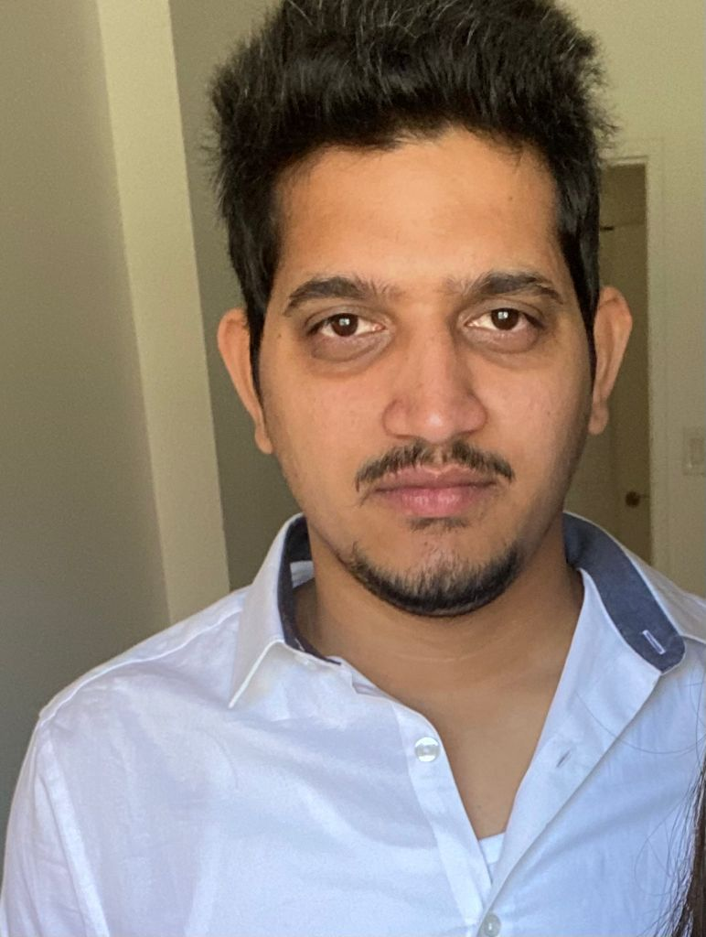
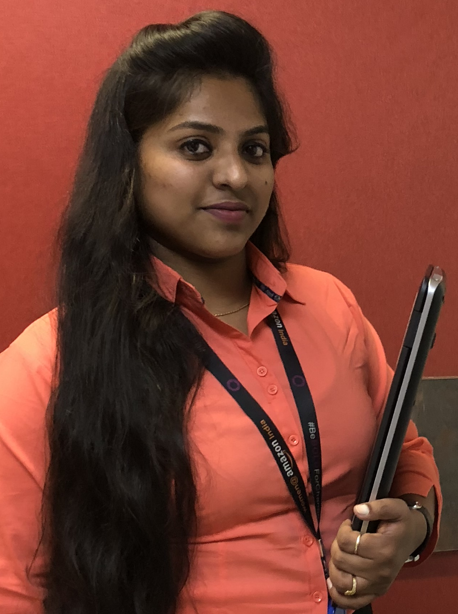
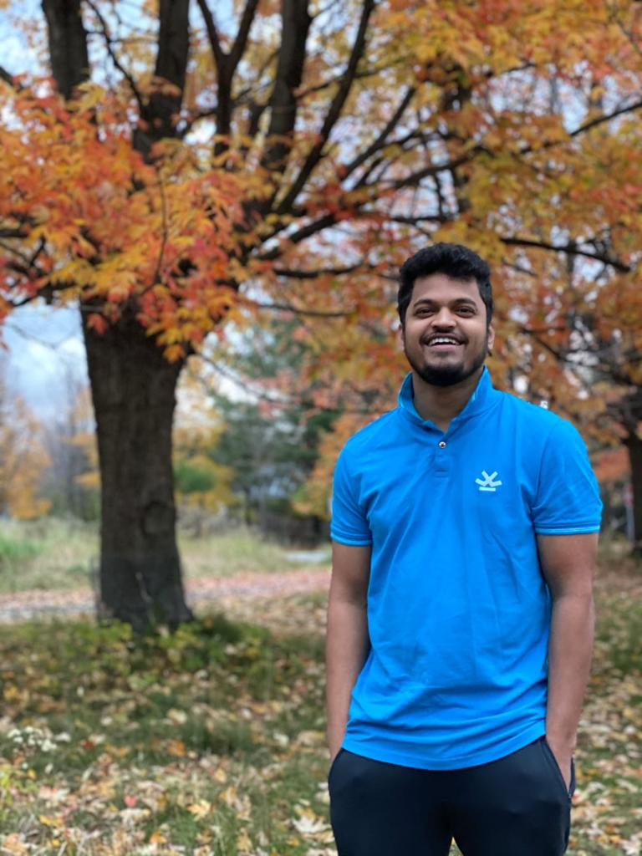
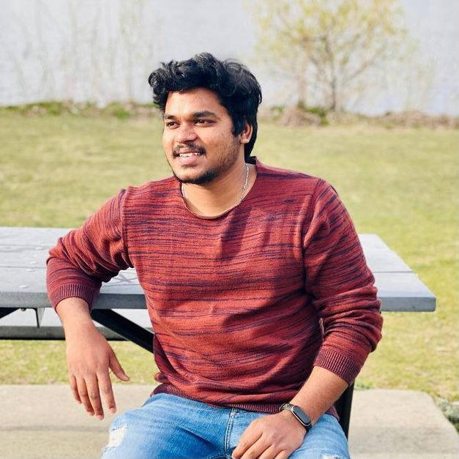
Team Presentation
Sai Nikhil Deekonda - 1994162
Admin: Register, home, login, user adapter, profile, splash screen, Student-teacher: home, login, User home, user select, view students, forgot password, Back End: SQL
Manoj Kumar - 2091243
events pojo, admin: home, comment view, comment event, Adapters: Comment, admin comment,participants,students,students my events
Naga Sravani Kurelli - 2091351
Student-teacher: profile, add event, my events, edit event, view event, event details, event participants, upcoming events
Sravan Kumar Adulapuram - 2091226
Admin: login, home, manage students & teachers, registration students & teacher, splash screen, Student-teacher: login, home
Rajesh Gurram - 1994148
Admin: edit Student, edit teacher, home, login. Back end: PHP

Slide 18
References
https://square.github.io/retrofit/
http://mytutorings.com/Android/TutorialsHub/Pages/UI/introduction.php
https://www.w3schools.com/php/php_mysql_insert.asp
https://github.com/Sravani1320/Scheduling-Events.git
MS Office
MS Word
MS PowerPoint
My SQL

Slide 19
Thank you!!

